Slide 1

Printer
Team 3
Song Yong Jae
Choi Soo Won
Tae Kyun Kim
Jinwoo Shimizu
Notes:
Good evening everyone! My name is ______ and today I will be sharing our product, the Braille printer

Slide 2
1
Introduction
2
Concept & Design
3
Arduino Code
4
Assembly
5
Performance
6
Conclusion
Notes:
Here is an overview of our presentation and what will be covered today. First, we will discuss the main problems with the current commercial braille printers

Slide 3
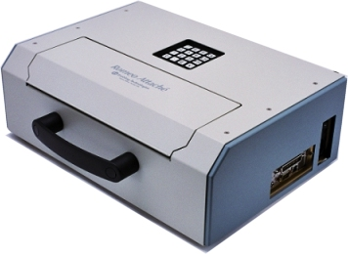
Problem Statement
Commercial braille printers are heavy and expensive
Cost on the Market
Small-volume : $1,800 ~ $5,000
Larger-volume : $10,000 ~ $80,000
Projected Cost of Our Braille Printer
$100 ~ $200
Notes:
The 2 biggest problems for the braille printers on the market today are that they are very bulky and very expensive. Some of them having a price of $10,000 just for the base model! This high price keeps the blind from being able to comfortably purchase and use the product even though it is a common item that can be used daily.
Therefore, for our design we decided to focus and keep these issues in mind as we brainstormed a way to improve on these problems.

Slide 4
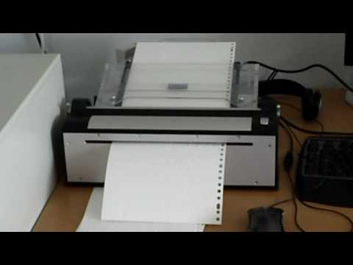
Commercial Printer Video
Notes:
Here is an example of a braille printer product used today.
(Plays video)
The braille printer is shown to be noisy and one can see the amount of space the printer makes up when placed on a desk

Slide 5
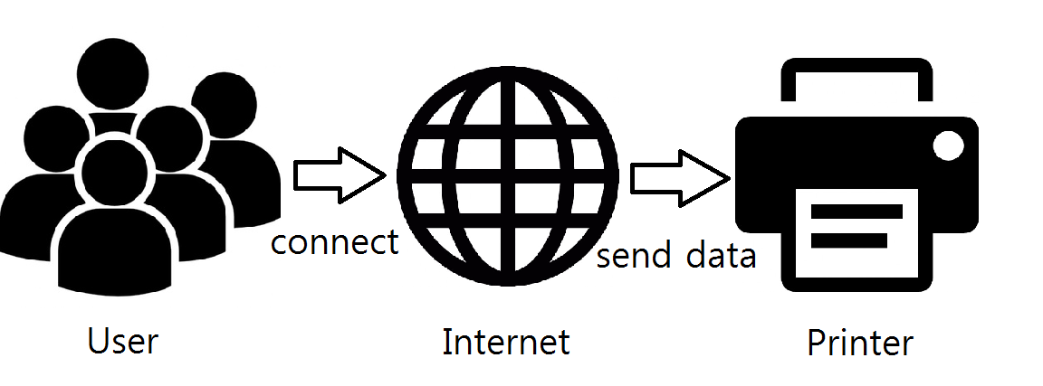
Our Project Goals
Criteria of our designed braille printer:
Lightweight
Cost-friendly (~$100)
Compatible (Wifi/Bluetooth)
Multiple settings to print
Durable (Case)
Notes:
Based on these problems introduced, our group has decided to implement the following in the new design of our braille printer. Having these ideas incorporated in our product, we can be confident that our design is more practical and useful for the user.

Slide 6
1
Introduction
2
Concept & Design
3
Arduino Code
4
Assembly
5
Performance
6
Conclusion
Notes:
Next, I will go over our concept and design for our braille printer redesign

Slide 7
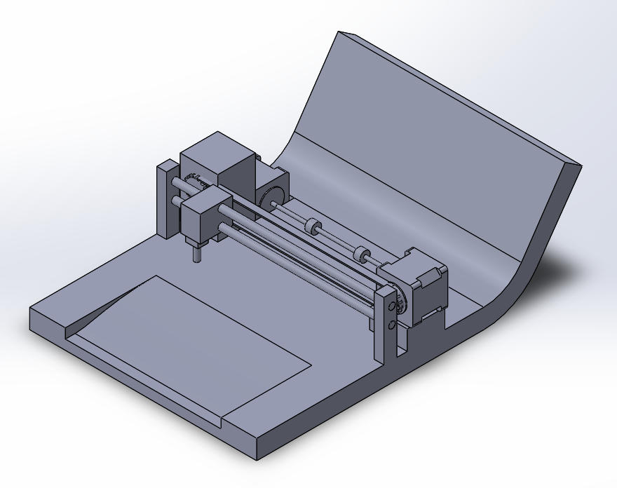
3D Modeling Design
Stepper Motors
Push-Pull Solenoid
Metal Rods
Base
Notes:
Here we have a 3D cad model diagram showing our first concept. The idea we have to consider is that the dot placement onto the paper has to be accurately placed and directed while also being able to change position quickly to the next dot placement in order to make the print as fast as possible. We chose to have a push solenoid to punch the hole and have 2 stepper motors to have the puncher move in the x direction and have the paper move in the y direction. The base and support structures are planned to be 3D printed

Slide 8
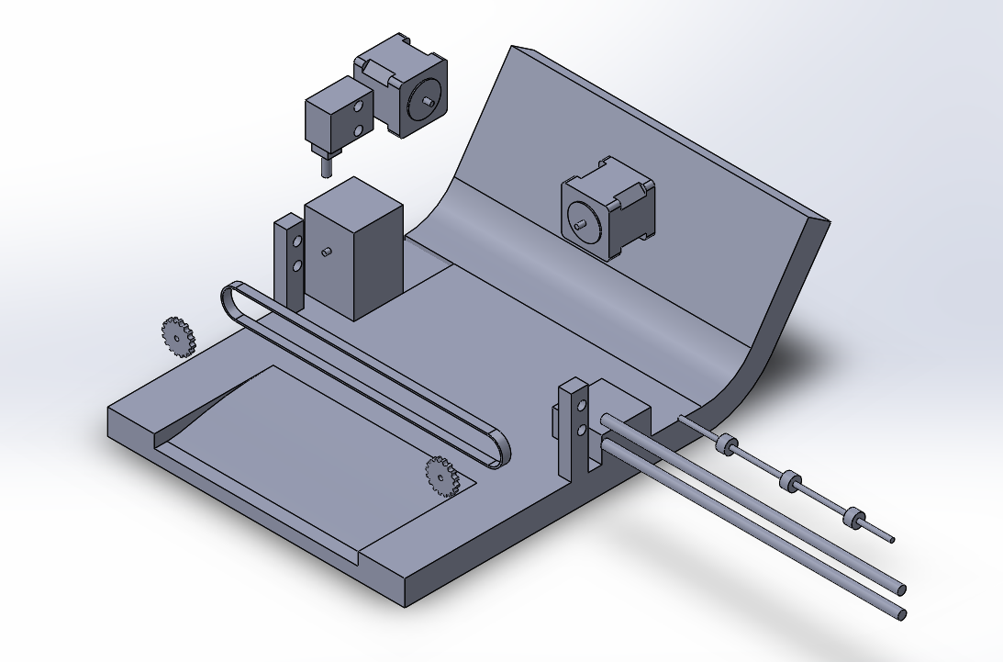
3D Modeling Design
Push Solenoid Actuator
Stepper Motors
Base
Shaft w/ rubber grips
Metal Rods
Notes:
We can see the components more clearly in the exploded view of the same CAD model. The metal rods are going to act as a constrained track where the push solenoid will move along. There is also a shaft with rubber grips used to move the paper along the y axis for dot placement

Slide 9
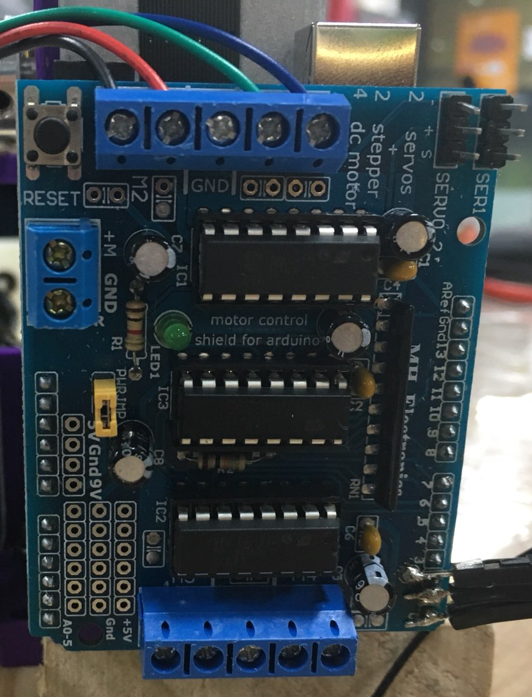
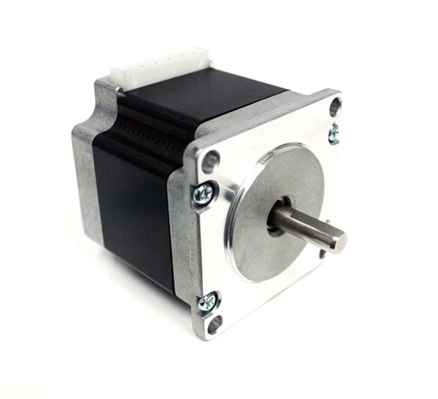
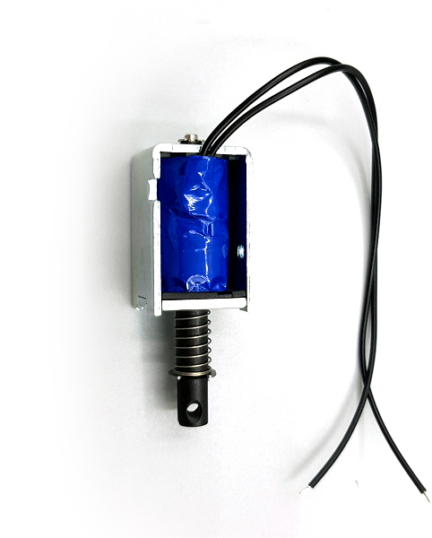
Components
Stepper Motor
Push Solenoid Actuator
Motor Driver
Notes:
We specifically chose stepper motors since it is able to hold a desired angle when specified. And unlike a servo motor, the stepper motor is able to rotate more than 360 degrees which is needed for the puncher to be able to travel across the length of the paper. Now, the push solenoid was chosen since it is a quick linear actuator that is easy to control. You just need to connect the solenoid to a voltage source and the solenoid pushed outward to a new position. All of this will be controlled with a motor driver arduino shield since the stepper motor requires a control circuit to function properly.

Slide 10
1
Introduction
2
Concept & Design
3
Arduino Code
4
Assembly
5
Performance
6
Conclusion
Notes:
Moving on, we will now go over the main idea and method behind our Arduino Code

Slide 11
Arduino Code: Concept

Slide 12
1
Introduction
2
Concept & Design
3
Arduino Code
4
Assembly
5
Performance
6
Conclusion
Notes:
Once we have our concept, design, and code ideas ready we began to assemble

Slide 13
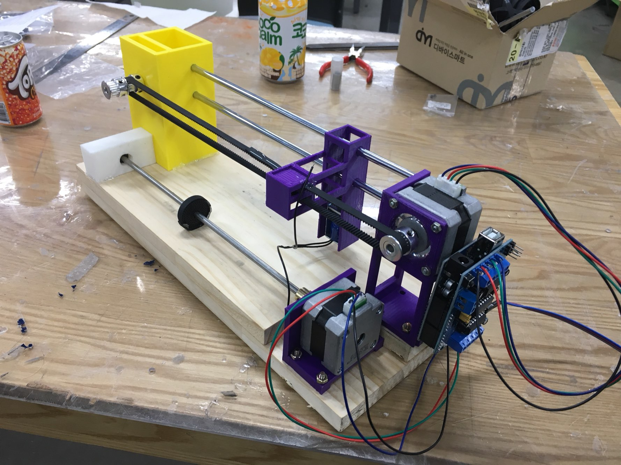
Final Assembly
Notes:
Now for our final assembly we ran into the problem of the base being too big to print for the 3D printer. Instead, we used a wooden block to act as a base since it can keep the assembly bolted and weighed down while also being able to have the paper to move smoothly on the surface. Other aspects of the assembly follow our design and concept well

Slide 14
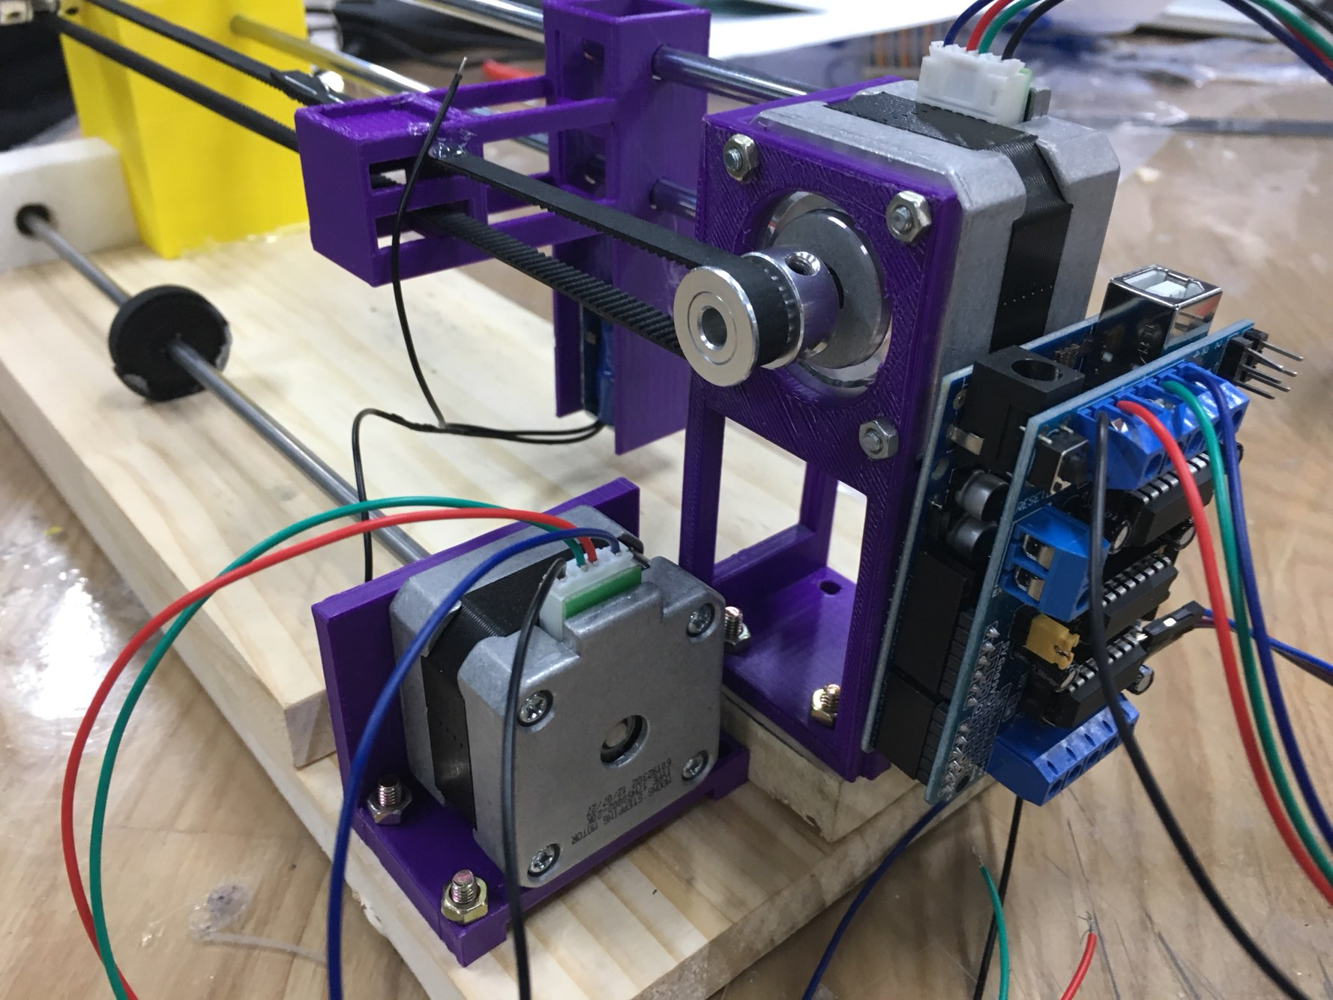
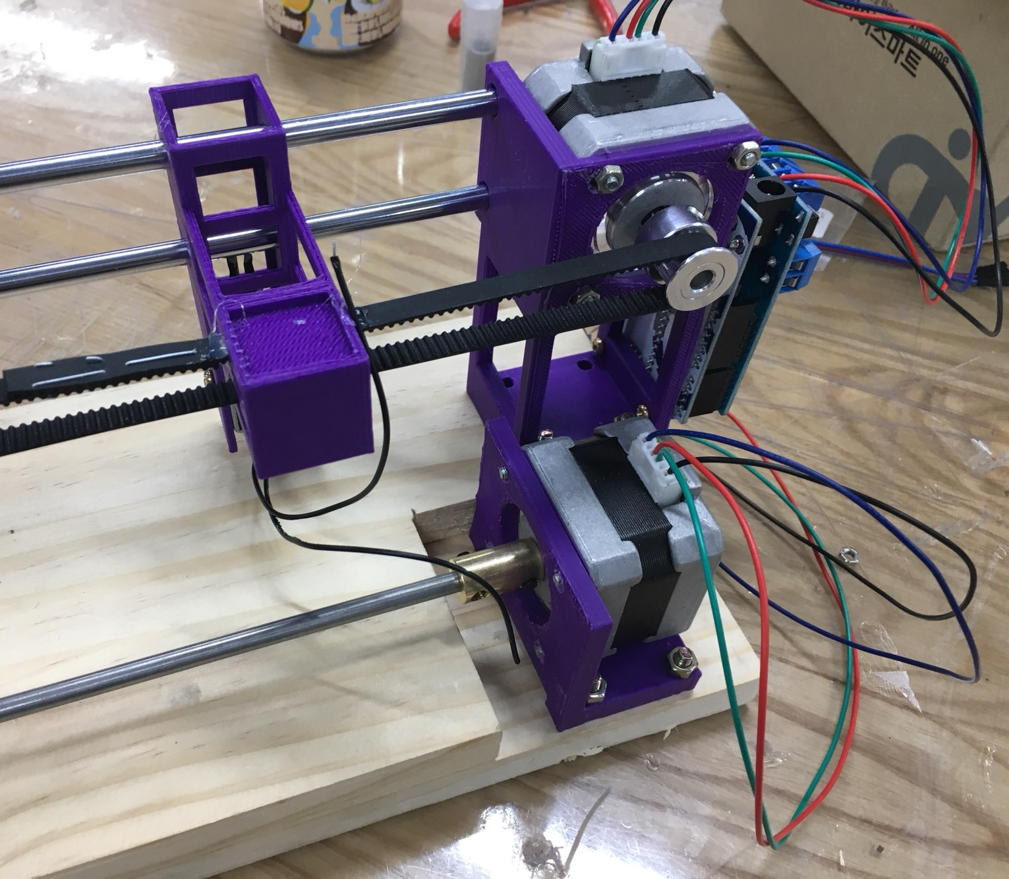
Final Assembly
Notes:
We see that the stepper motors are used to move the push solenoid along the metal rods through a track system by following our design. And having the paper move along the y axis using the shaft and the rubber grips.

Slide 15
1
Introduction
2
Concept & Design
3
Arduino Code
4
Assembly
5
Performance
6
Conclusion
Notes:
Now let’s look at how the our braille printer performs!

Slide 16
Performance Video
Notes:
(Play video of braille printer performance)

Slide 17
Performance Stats
State the number of punches per minute/second
Words per minute
Other information
Notes:
We’ve found the following results based on the performance of our braille printer design

Slide 18
1
Introduction
2
Concept & Design
3
Arduino Code
4
Assembly
5
Performance
6
Conclusion
Notes:
Now there are many ideas that we’ve learned from this project and room more improvement

Slide 19
Possible Improvements
Implement more than one push solenoid actuator to decrease printing time
Incorporate better housing material for printer
Make powered by battery/wall plug-in
Notes:
We feel that we can decrease printing time even more by implementing another push solenoid actuator. We can also focus on improving the housing of the printer to be more safe for the user and make it accessible to home wall plug-in or battery-powered to make it more portable.

Slide 20
What We’ve Learned
Not everything goes according plan when designing and assembling
Utilization of Wifi/Bluetooth communication
Stepper motor control
Braille Language
Notes:
There are many things that we’ve learned from this project such as having to be able to change a plan when something doesn’t completely follow. As well as many mechatronics practices like: stepper motor control and utilization of Wifi/Bluetooth communication.

Slide 21

Thank You!

